Slide 1
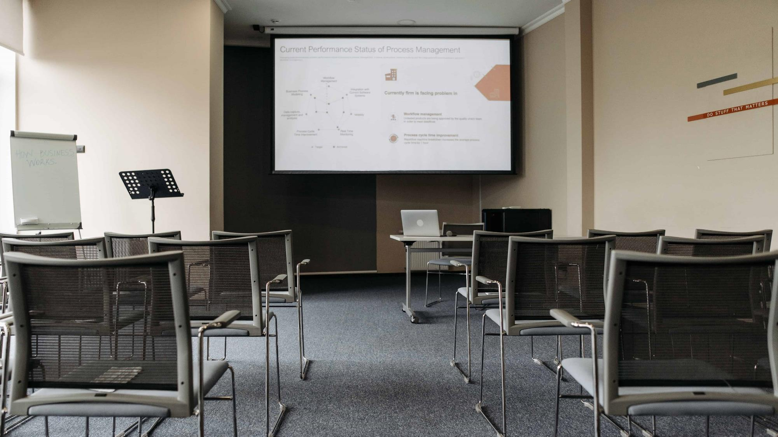
Exercises on Improving the Readability of Presentation Slides
Dr Muhammad Hijazy
Notes:
https://www.myhijazz.com/

Slide 2
Disclaimer
This file contains texts that were copied/pasted from random blogs and websites.
As the exercises in the file focus on the slide design and text formatting; the texts were not included for their information value, but as materials to demonstrate the slide design and text formatting techniques on.
Therefore, the sources, from which the texts were taken, were not cited and the original texts were not paraphrased.
However, links to the sources were provided in the slides’ notes section.

Slide 3
Exercise 1
Improve the readability of the next slide

Slide 4
Here are some of the specific reasons why English learners are encouraged to read in English:
The constant repetition of words and patterns in reading helps you learn and remember vocabulary and grammar structures. Reading helps you become familiar with the rhythm of English. Unlike conversation, reading is something you can do on your own. Good reading skills can improve your other language skills. You need to learn to read before you can write. Reading is the best way to learn and remember the proper spelling of words. Listening as you read aloud can help you improve your pronunciation skills
Notes:
Source text: https://languageadvisor.net/reading-shelf-1-student-book-with-audio/

Slide 5
Why should English learners read in English?
The constant repetition of words and patterns in reading helps you learn and remember vocabulary and grammar structures.
Reading helps you become familiar with the rhythm of English.
Unlike conversation, reading is something you can do on your own.

Slide 6
Why should English learners read in English? (cont.)
Good reading skills can improve your other language skills. You need to learn to read before you can write.
Reading is the best way to learn and remember the proper spelling of words.
Listening as you read aloud can help you improve your pronunciation skills.

Slide 7
Exercise 2
Improve the readability of the next slide

Slide 8
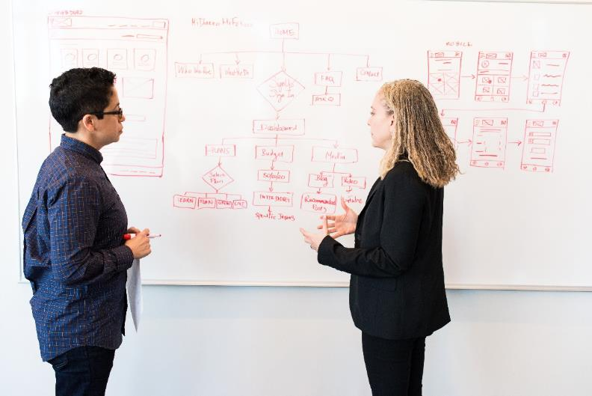
Ways to Overcome Procrastination
Get out your calendar.
Be realistic.
Get a partner.
Optimise your environment.
Reward good behaviour.
Drop the perfectionism.
Notes:
Source text: https://www.psychologytoday.com/gb/blog/better-perfect/201703/11-ways-overcome-procrastination

Slide 9
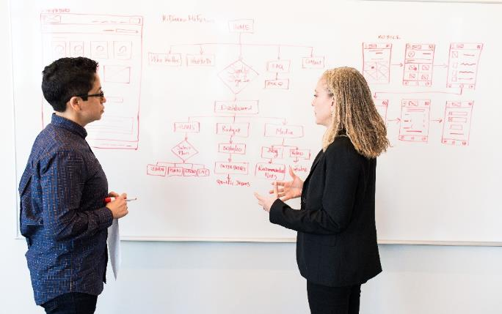
Ways to Overcome Procrastination
Get out your calendar.
Be realistic.
Get a partner.
Optimise your environment.
Reward good behaviour.
Drop the perfectionism.

Slide 10
Exercise 3
Improve the readability of the next slide

Slide 11
Techniques to improve time management:
Start your tasks early.
Set limits for what you’ll say yes to.
Give yourself breaks.
Prioritise your tasks.
Schedule your tasks and deadlines.
Organise your workplace.
Learn your patterns of productivity.
Use technology to help keep you accountable.
Focus on one task at a time.
Reinforce your good habits.
Notes:
Source text: https://www.indeed.com/career-advice/career-development/improve-time-management-skills

Slide 12
Techniques to improve time management
Start your tasks early.
Set limits for what you’ll say yes to.
Give yourself breaks.
Prioritise your tasks.
Schedule your tasks and deadlines.
Organise your workplace.
Learn your patterns of productivity.
Use technology to help keep you accountable.
Focus on one task at a time.
Reinforce your good habits.

Slide 13
Exercise 4
Improve the readability of the next slide

Slide 14
Reading Strategies
Think about where you focus best on your reading. This may be at home or in a calm place away from distractions, such as the Library.
Adapt your reading speed according to the text and the purpose of your reading. How fast you should go will depend on what you already know about the subject, how difficult the text is, and how thoroughly you need to understand it.
You cannot read intensively for hours. Divide up reading time into several sessions rather than a single long one. But if sessions are too short, you will not have time to get properly into the frame of thinking required. Observe and improve your own habits.
Notes:
Source text: https://www.sussex.ac.uk/skillshub/?id=276

Slide 15
Reading Strategies
Think about where you focus best on your reading.
Adapt your reading speed according to the text and the purpose of your reading.
You cannot read intensively for hours. Divide up reading time into several sessions rather than a single long one.

Slide 16
Exercise 5
Improve the readability of the next slide

Slide 17
In this presentation, we will discuss:
01
The definition of teamwork skills.
02
What teamwork skills are essential to the workplace.
03
How to list good teamwork skills on a resume.
04
Examples of teamwork skills.
05
How to improve your teamwork skills.

Slide 18
CONTENTS
The definition of teamwork skills.
What teamwork skills are essential to the workplace.
How to list good teamwork skills on a resume.
Examples of teamwork skills.
How to improve your teamwork skills.

